Slide 1




MS
PowerPoint
Class V
lab 22

Slide 2

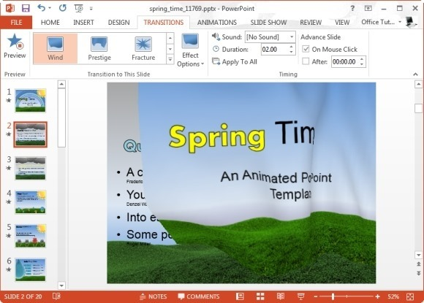
PowerPoint Transition
slide transitions are motion effects that occur in Slide Show view when you move from one slide to the next during a presentation

Slide 3
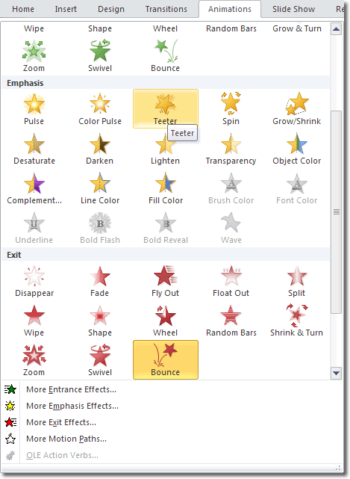
Animation For PowerPoint
To add a custom animation to an object in Microsoft PowerPoint, first of all select the object, then click animation in the ribbon then choose one of your favourite

Slide 4
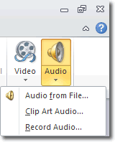
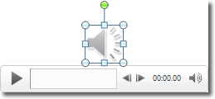
Inserting Sound
you can use audio clip art from powerpoint library or any specific audio file from your computer

Slide 5
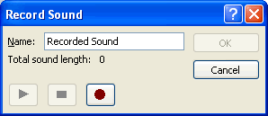
Record Audio
The record audio option gives you the ability to record your own sound clip within PowerPoint. All you need is a microphone to record your voice

Slide 6


